Slide 1
Chapter 3
Project management

Slide 2
Objectives：
To explain the principal tasks undertaken by project managers
To introduce software project management and to describe its distinctive characteristics
To discuss project planning and the planning process
To show how graphical schedule representations are used by project management
To discuss the notion of risks and the risk management process
Notes:
Software management is a big topic, can not covered in only one chapter.

Slide 3
Topics covered
Management activities
Project planning
Project scheduling
Risk management

Slide 4
Why management
SE
  Technical
  Management
Management is an essential part of software. We need software project management because it is always subject to budget and schedule constraints.
你不理财，财不理你
人的成功：IQ ，EQ, SQ…
Notes:
丁肇中：我只面对上帝。 I was dismay(frustrated) by the situation such as evaluation principle of today’s students.

Slide 5
Why management (continued)
Good management cannot guarantee project success. However, bad management usually results in project failure: delivered late, cost more than originally estimated and fails to meet its requirements.

Slide 6
What
Project planning
Project scheduling
Risk management
Managing people
Software cost estimation
Quality management

Slide 7
How
Manager

Slide 8
Software management distinctions
The product is intangible.
The product is uniquely flexible.
Software engineering is not recognized as an engineering discipline with the sane status as mechanical, electrical engineering, etc.
The software development process is not
standardised.
Many software projects are 'one-off' projects.
Given these difficulties, over budget, behind schedule is not surprising.
Notes:
Software engineers do the same kind of job as other engineering project managers, however software engineering is different from other types of engineering in a number of ways, These distinctions make software management particularly difficult.

Slide 9
Management activities
Proposal writing. Win a contract
Project planning and scheduling.
Project costing.
Project monitoring and reviews.
Personnel selection and evaluation.
Report writing and presentations.
Notes:
It is impossible to write a standard job description for a software manager. The job varies tremendously depending on the organization and the software developed. However, most managers take responsibility at some stage for some or all of the following activities:

Slide 10
Management commonalities
These activities are not peculiar to software management.
Many techniques of engineering project
management are equally applicable to software project management.
Technically complex engineering systems tend to suffer from the same problems as software systems.

Slide 11
Proposal writing
First stage task
Describes the objectives of the project and how it will be carried out.
Includes cost and schedule estimates
Justify why the project contract should be awarded to you
It is a critical task. Win a contract.

Slide 12
Project staffing
May not be possible to appoint the ideal people to work on a project
  Project budget may not allow for the use of highly-paid staff;
  Staff with the appropriate experience may not be available;
  An organisation may wish to develop employee skills on a software project.
Managers have to work within these constraints especially when there are shortages of trained staff.

Slide 13
Project planning
Concerning with
  identifying the activities
  Milestones, and
  Deliverables
A plan guides the development towards the project goals.

Slide 14
Project planning (continued)
Probably the most time-consuming project management activity.
Continuous activity from initial concept through
to system delivery. Plans must be regularly revised as new information becomes available.
Various different types of plan may be developed to support the main software project plan that is concerned with schedule and budget.

Slide 15
The project plan
The project plan sets out:
  The resources available to the project;
  The work breakdown;
  A schedule for carrying out the work.

Slide 16
Generic project plan structure
Introduction
  describing project objectives
  setting out the constraints, e.g. budget, time, etc
Project organization
  Way in which the team is organised
  people involved and
  Their roles in the team.
Notes:
The details of the project plan vary depending on the type of project and organisation.

Slide 17
Generic project plan structure (continued)
Risk analysis
  possible risks
  Likelihood of these risks arising
  Proposing risk reduction strategies
Hardware and software resource requirements.
Work breakdown
  Partitioning the whole project into coherent activities
  Identifing the milestones and deliverables associated with each activity.
Notes:
The details of the project plan vary depending on the type of project and organisation.

Slide 18
Generic project plan structure (continued)
Project schedule
  Dependencies between activities
  Estimated time needed to reach each milestones
  Allocation of people to activities.
Monitoring and reporting mechanisms.
  Management report produced, when
  Project monitoring mechanism used.
Project plan should be revised regularly, especially for project schedule
Notes:
The details of the project plan vary depending on the type of project and organisation.

Slide 19
Activity organization: milestones, deliverable
Activities in a project should be organised to produce tangible outputs for management to judge progress.
Milestones are the end-point of a process activity.
  A formal output presented to management.
Deliverables are project results delivered to customers.
Deliverables are usually milestones, not vice versa.
Notes:
Manager need information to do their job, which can only be provided as reports and documents that describe the state of the software. Without this information, it is impossible to asses how well the project is progressing , and cost estimates and schedules cannot be updated.

Slide 20
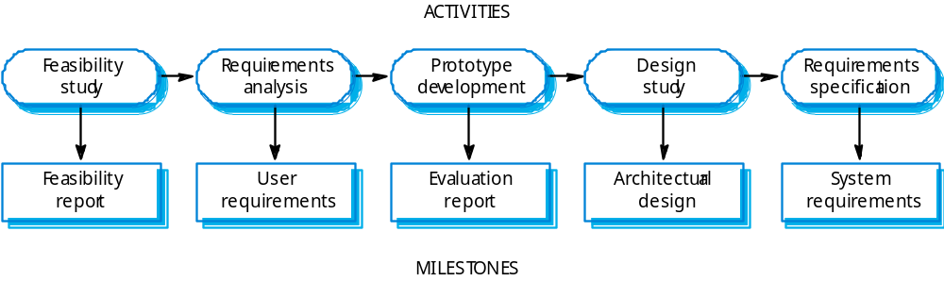
Milestones in the RE process
Deliverables: requirements definition and requirements specification

Slide 21
Project scheduling
Split project into tasks and estimate time and resources required to complete each task.
Organize tasks concurrently to make optimal
use of workforce.
Minimize task dependencies to avoid delays
caused by one task waiting for another to complete.
Dependent on project managers intuition and experience.

Slide 22
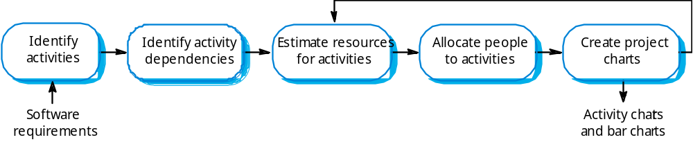
The project scheduling process

Slide 23
Scheduling problems
Project scheduling is one of the most difficult job for project manager:
Estimating the difficulty of problems and hence the cost of developing a solution is hard.
Productivity is not proportional to the number of people working on a task.
Adding people to a late project makes it later because of communication overheads.
The unexpected always happens. Always allow contingency in planning.

Slide 24
Bar charts and activity networks
Schedules are usually represented as a set of charts:
Graphical notations used to illustrate the project schedule.
Show project breakdown into tasks. Tasks should not be too small. They should take about a week or two.
Activity charts show task dependencies and the the critical path.
Bar charts show schedule against calendar time.
Notes:
These charts can be automatically produced by tool, such as Microsoft project.

Slide 25
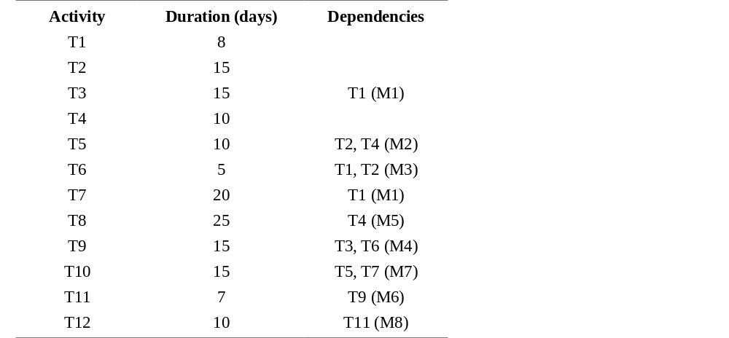
Task durations and dependencies

Slide 26
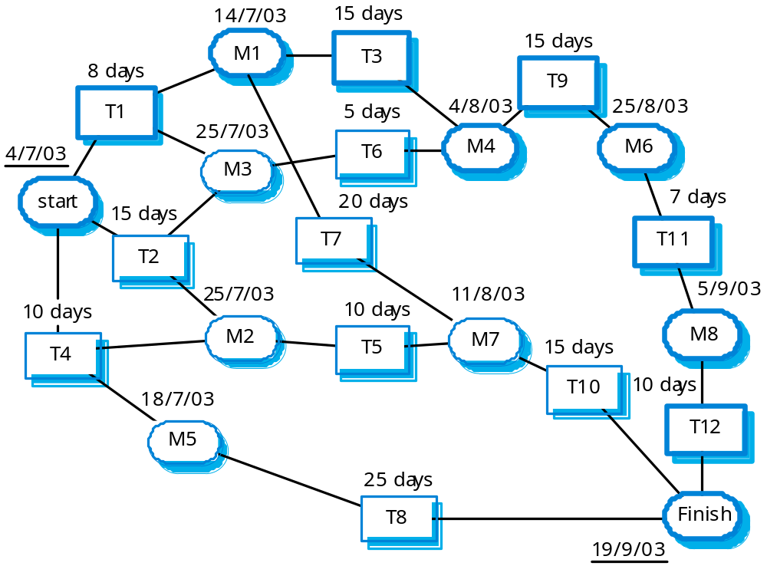
Activity network

Slide 27
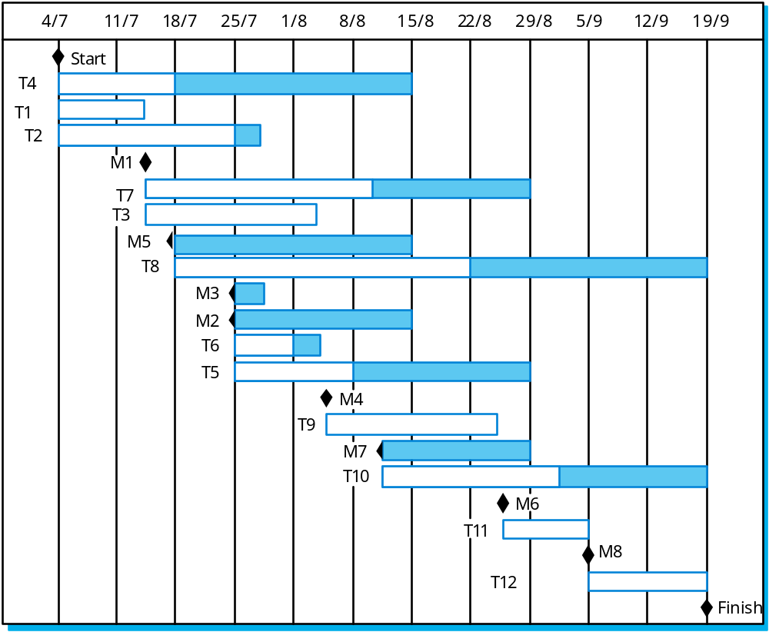
Activity timeline

Slide 28
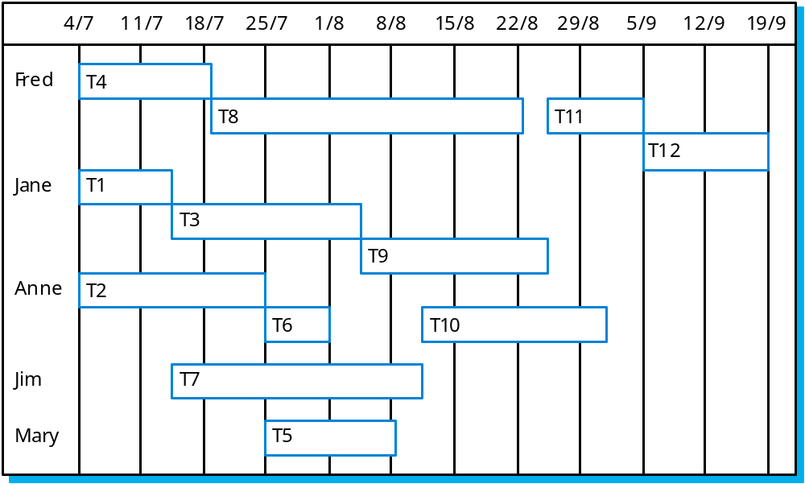
Staff allocation

Slide 29
Risk management
Project faces inherent uncertainties, which may cause variant risks.
Risk management is increasingly seen as one of he main jobs of project managers.
Effective risk management makes it easier to cope with problems and to ensure that these do not lead to unacceptable budget or schedule slippage.

Slide 30
Risk management
Risk management is concerned with identifying risks and drawing up plans to minimise their effect on a project.
A risk is a probability that some adverse circumstance will occur
  Project risks affect schedule or resources;
  Product risks affect the quality or performance of the software being developed;
  Business risks affect the organisation developing or procuring the software.

Slide 31
The risk management process
Risk identification
  Identify project, product and business risks;
Risk analysis
  Assess the likelihood and consequences of these risks;
Risk planning
  Draw up plans to avoid or minimise the effects of the risk;
Risk monitoring
  Monitor the risks throughout the project;

Slide 32
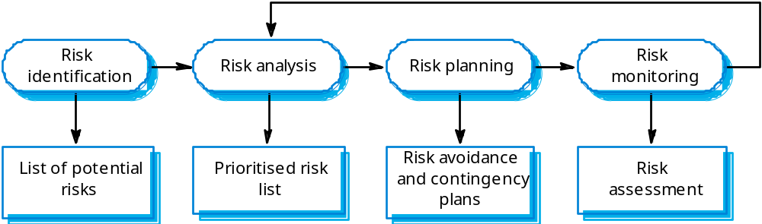
The risk management process

Slide 33
Risk identification
Technology risks.
People risks.
Organisational risks.
Requirements risks.
Estimation risks.

Slide 34
Risk analysis
Assess probability and seriousness of each risk.
Probability may be very low, low, moderate, high or very high.
Risk effects might be catastrophic, serious, tolerable or insignificant.

Slide 35
Risk planning
Consider each risk and develop a strategy to manage that risk.
Avoidance strategies
  The probability that the risk will arise is reduced;
Minimisation strategies
  The impact of the risk on the project or product will be reduced;
Contingency plans
  If the risk arises, contingency plans are plans to deal with that risk;

Slide 36
Risk monitoring
Assess each identified risks regularly to decide whether or not it is becoming less or more probable.
Also assess whether the effects of the risk have changed.
Each key risk should be discussed at management progress meetings.

Slide 37
Key points
Good project management is essential for project success.
The intangible nature of software causes problems for management.
Managers have diverse roles but their most significant activities are planning, estimating and scheduling.
Planning and estimating are iterative processes
which continue throughout the course of a
project.

Slide 38
Key points
A project milestone is a predictable state where a formal report of progress is presented to management.
Project scheduling involves preparing various graphical representations showing project activities, their durations and staffing.
Risk management is concerned with identifying risks which may affect the project and planning to ensure that these risks do not develop into major threats.

